Slide 1
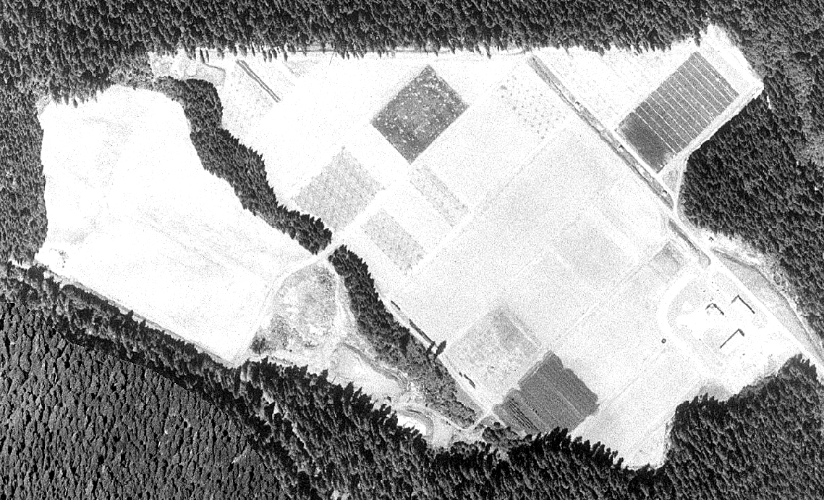
PNW-Managed Fields 2010 Agreement
Research Field ~ 3.6 ha.
Research Field ~ 3.4 ha
AMAT
road
#2128
#2123
Offices and meeting area ~ 2800 sq. m.
Bldg # 2128, two bays in # 2123 north end
Microclimate station area ~ 400 sq. m.
with AC power from #2123
PNW agreement area boundaries
Main access road

